Slide 1
Why digital signals are needed?

Slide 2

Difference between analog and digital signal
Analog signals | Digital signals
Analog signals are difficult to get analysed at first. | Digital signals are easy to analyse.
Analog signals are more accurate than digital signals. | Digital signals are less accurate.
Analog signals take time to be stored. It has infinite memory. | Digital signals can be easily stored.
To record an analog signal, the technique used, preserves the original signals. | In recording digital signal, the sampled signals are taken and preserved.
There is a continuous representation of signals in analog signals. | There is a discontinuous representation of signals in digital signals.
Analog signals produce too much noise. | Digital signals do not produce noise.
Examples of analog signals are Human voice, Thermometer, Analog phones etc. | Examples of digital signals are Computers, Digital Phones, Digital pens, etc.

Slide 3
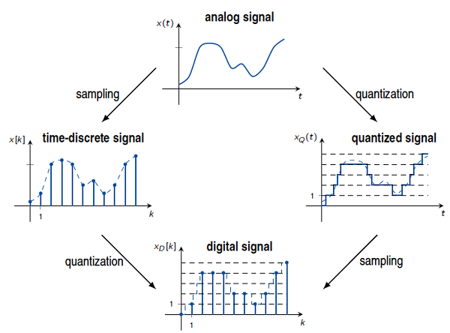

Difference between analog and digital signal

Slide 4
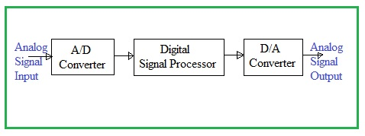
Difference between analog and digital signal

Slide 5

Binary Logic and Gates
Binary variables take on one of two values.
Logical operators operate on binary values and binary variables.
Basic logical operators are the logic functions AND, OR and NOT.
Logic gates implement logic functions.
Boolean Algebra: a useful mathematical system for specifying and transforming logic functions.
We study Boolean algebra as a foundation for designing and analyzing digital systems!

Slide 6
Binary Variables
Recall that the two binary values have different names:
True/False
On/Off
Yes/No
1/0
We use 1 and 0 to denote the two values.
Variable identifier examples:
A, B, y, z, or X₁ for now
RESET, START_IT, or ADD1 later

Slide 7
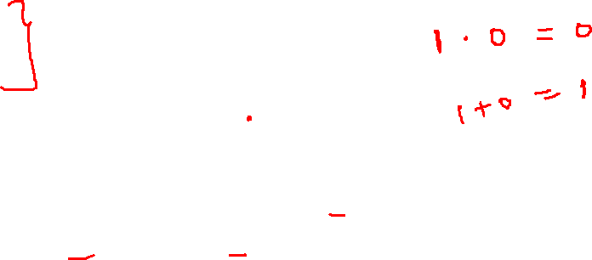
Logical Operations
The three basic logical operations are:
AND
OR
NOT
AND is denoted by a dot (·).
OR is denoted by a plus (+).
NOT is denoted by an overbar ( ¯ ), a single quote mark (') after, or (~) before the variable.

Slide 8

Notation Examples
Examples:
is read “Y is equal to A AND B.”
is read “z is equal to x OR y.”
is read “X is equal to NOT A.”
Y
=
A
×
B
z
=
x
+
y
X
=
A
Note: The statement:
1 + 1 = 2 (read “one plus one equals two”)
is not the same as
1 + 1 = 1 (read “1 or 1 equals 1”).
In ordinary Alegbra
A + A = 2A & A.A= A² where as in BA, A + A = A & A.A = A

Slide 9
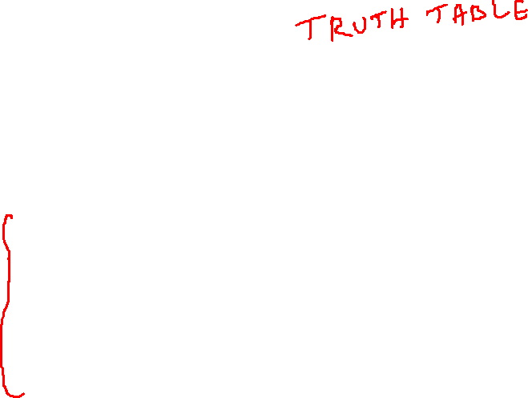
Operator Definitions
Operations are defined on the values "0" and "1" for each operator:
AND
OR
NOT
0 · 0 = 0
0 + 0 = 0
0
=
1
0 · 1 = 0
0 + 1 = 1
1
=
0
1 · 0 = 0
1 + 0 = 1
1 · 1 = 1
1 + 1 = 1

Slide 10
Truth Tables
Tabular listing of the values of a function for all possible combinations of values on its arguments
Example: Truth tables for the basic logic operations:
AND
OR
X | Y | Z = X+Y
0 | 0 | 0
0 | 1 | 1
1 | 0 | 1
1 | 1 | 1
NOT
X
Y
Z = X·Y
X
Z
=
X
0
0
0
0
1
0
1
0
1
0
1
0
0
1
1
1

Slide 11

Truth Tables – Cont’d
Used to evaluate any logic function
Consider F(X, Y, Z) = X Y + Y Z
X | Y | Z | X Y | Y | Y Z | F = X Y + Y Z
0 | 0 | 0 | 0 | 1 | 0 | 0
0 | 0 | 1 | 0 | 1 | 1 | 1
0 | 1 | 0 | 0 | 0 | 0 | 0
0 | 1 | 1 | 0 | 0 | 0 | 0
1 | 0 | 0 | 0 | 1 | 0 | 0
1 | 0 | 1 | 0 | 1 | 1 | 1
1 | 1 | 0 | 1 | 0 | 0 | 1
1 | 1 | 1 | 1 | 0 | 0 | 1

Slide 12
Logic Gate Symbols and Behavior
Logic gates have special symbols:
And waveform behavior in time as follows:
X
X
Z
=
X
·
Y
Z
=
X
+
Y
X
Z
=
X
Y
Y
AND gate
OR gate
NOT gate or
inverter
X
0
0
1
1
Y
0
1
0
1
(AND)
X
·
Y
0
0
0
1
(OR)
X
+
Y
0
1
1
1
(NOT)
X
1
1
0
0

Slide 13
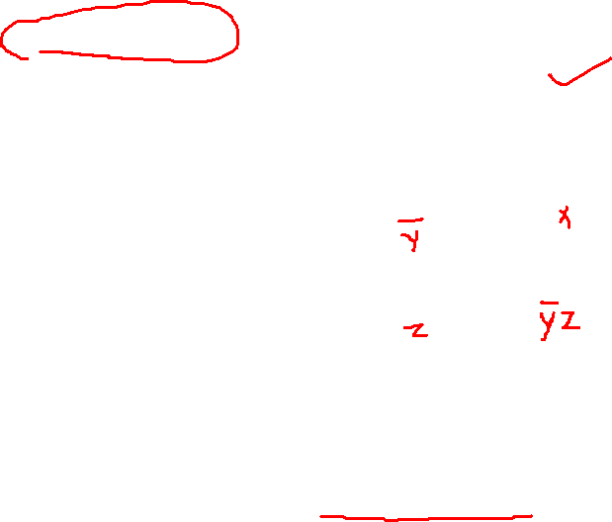
Logic Diagrams and Expressions
Truth Table
Logic Equation
X Y Z
F
=
X
+
Y
×
Z
0 0 0
0
F
=
X
+
Y
Z
0 0 1
1
0 1 0
0
Logic Diagram
0 1 1
0
X
1 0 0
1
1 0 1
1
Y
F
1 1 0
1
Z
1 1 1
1
Boolean equations, truth tables and logic diagrams describe the same function!
Truth tables are unique, but expressions and logic diagrams are not. This gives flexibility in implementing functions.

Slide 14
Postulates of Boolean Algebra
Three basic logic operations, AND, OR & NOT
1. 0.0 = 0 6. 0 + 1 = 1
2. 0.1 = 0 7. 1 + 0 = 1
3. 1.0 = 0 8. 1 + 1 = 1
4. 1.1 = 1 9. 1 = 0
5. 0+0 = 0 10. 0 = 1

Slide 15
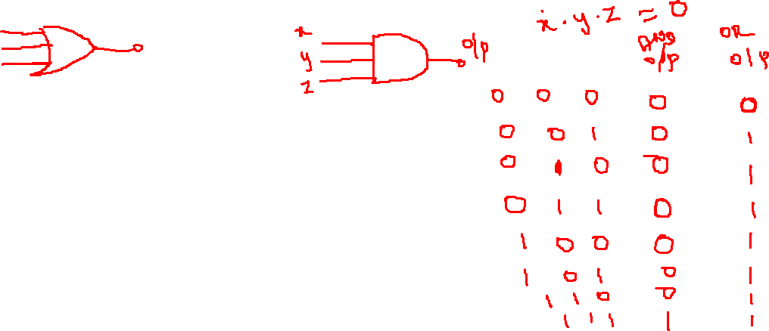
Variable – is a symbol used to represent logical quantity, Any single variable can have a 1 or a 0 value.
Complement – is the inverse of a variable and is indicated by a bar over the variable, e.g., A
Literal - is a variable or the complement of a variable

Slide 19
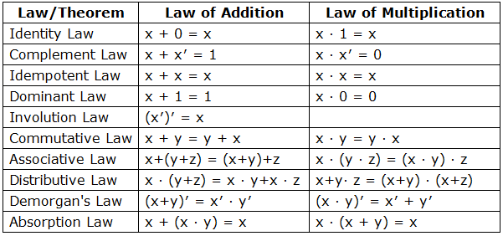

Slide 20
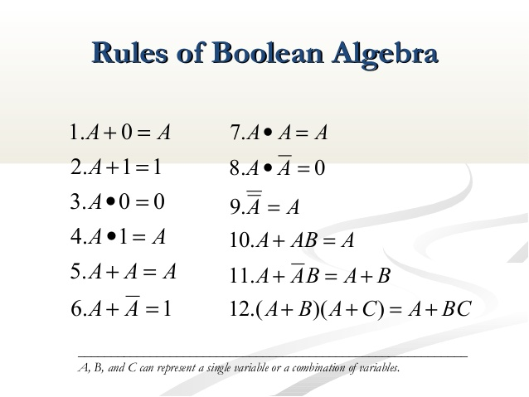

Slide 21
Commutative Laws
The commutative law of addition for two variables is written as: A+B = B+A
The commutative law of multiplication for two variables is written as: AB = BA
A
A+B
B
B+A
B
A
A
AB
B
BA
B
A

Slide 22
Associative Laws
The associative law of addition for 3 variables is written as: A+(B+C) = (A+B)+C
The associative law of multiplication for 3 variables is written as: A(BC) = (AB)C
A
A
A+B
A+(B+C)
B
B
(A+B)+C
C
B+C
C
A
A(BC)
A
AB
B
B
(AB)C
C
BC
C

Slide 23
Distributive Laws
The distributive law is written for 3 variables as follows: A(B+C) = AB + AC
B
B+C
A
AB
C
B
X
X
A
A
C
AC
X=A(B+C)
X=AB+AC
A+BC = (A+B) (A+C)
A + AB = A + B

Slide 31
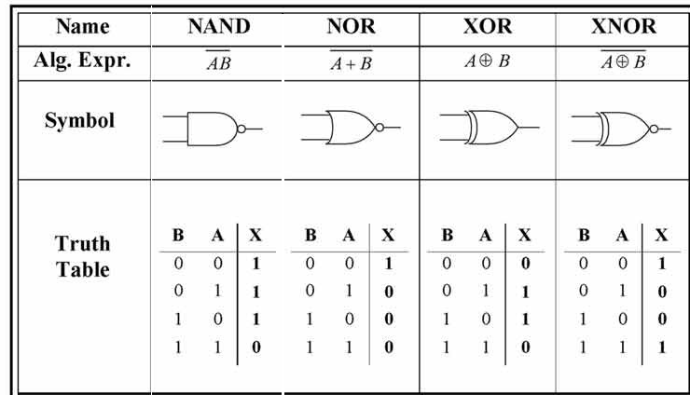
Additional Gates

Slide 32
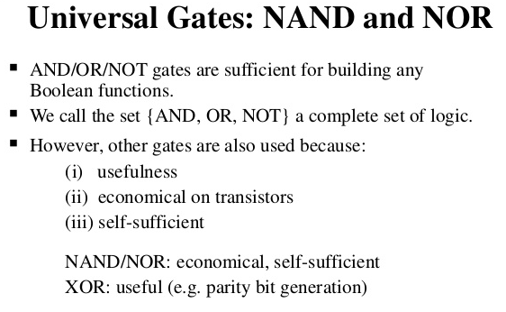

Slide 33
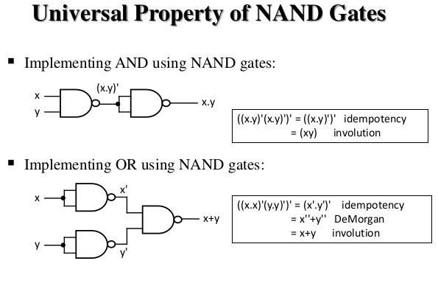

Slide 34
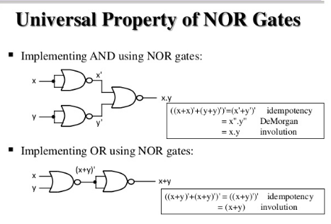

Slide 35
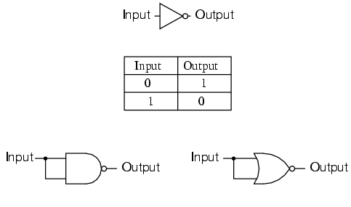
NOT gate using NAND and NOR

Slide 36
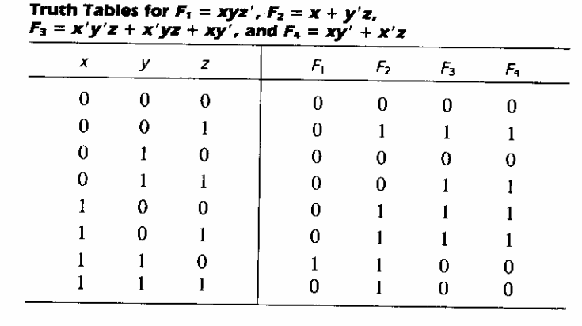

Slide 37
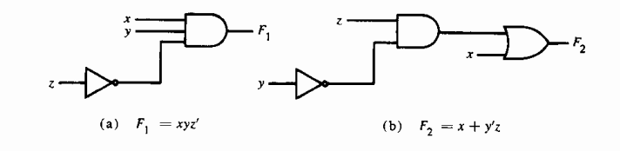
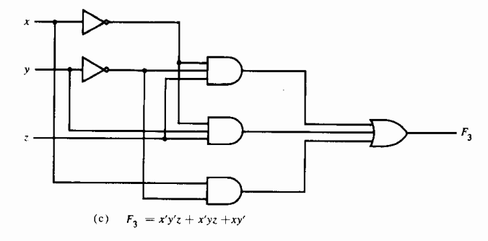

Slide 38
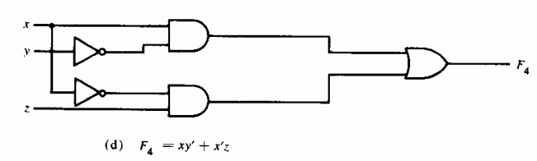

Slide 39
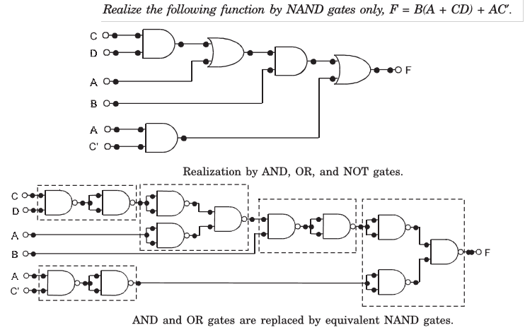
Realization using universal gates (only NAND)

Slide 40
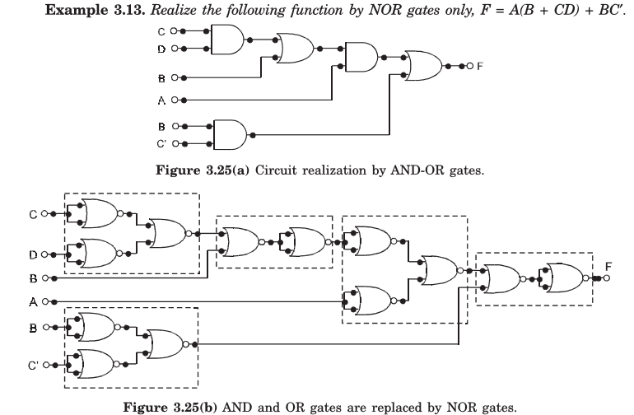
Realization using universal gates (only NOR)

Slide 41
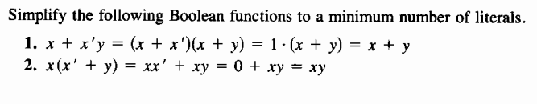
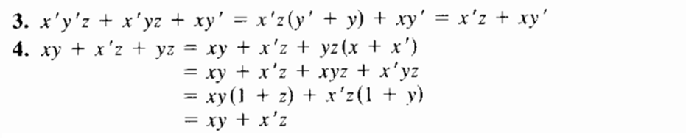

Slide 42
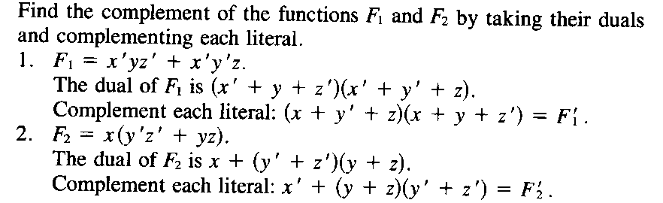
Finding the complement of a function

Slide 43
Canonical and standard forms
Logic function can be expressed in two forms
Sum of products (SOP)
Product of sums (POS)

Slide 44
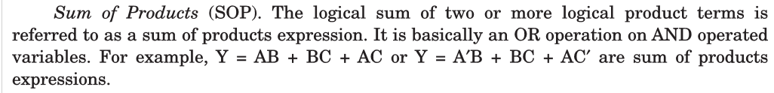
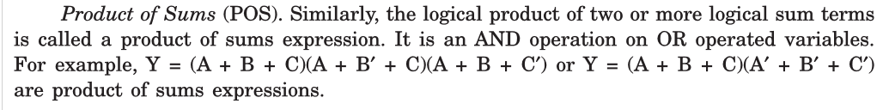
Canonical and standard forms

Slide 45
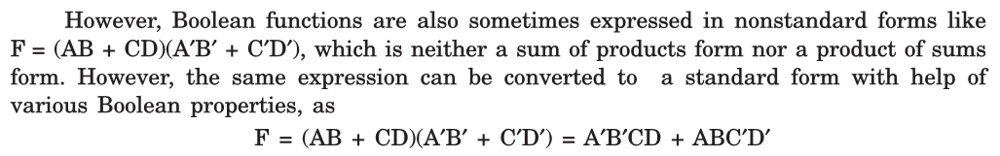
Canonical and standard forms

Slide 46
Minterms and Maxterms
A binary variable may appear in its normal form and its complement form
Four possible combinations are available for two binary variables x , y in AND operation
Each combination is called a minterm or a standard product (x’y’,x’y,xy’,xy)
For n variables 2^{n} minterms are possible
Similarly n variables forms in OR terms with each variable being primed or unprimed
This is known are maxterms or a standard sums (x+y, x+y’, x’+y, x’+y’)

Slide 47
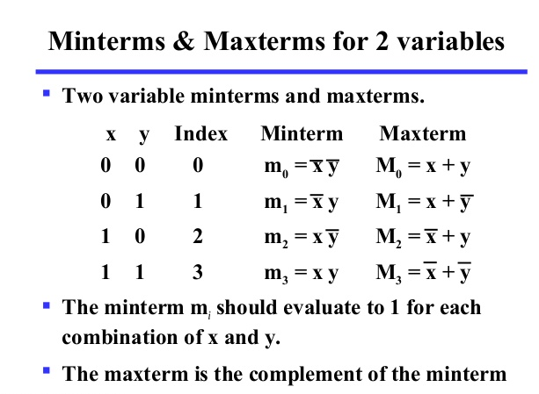
Minterms and Maxterms

Slide 48
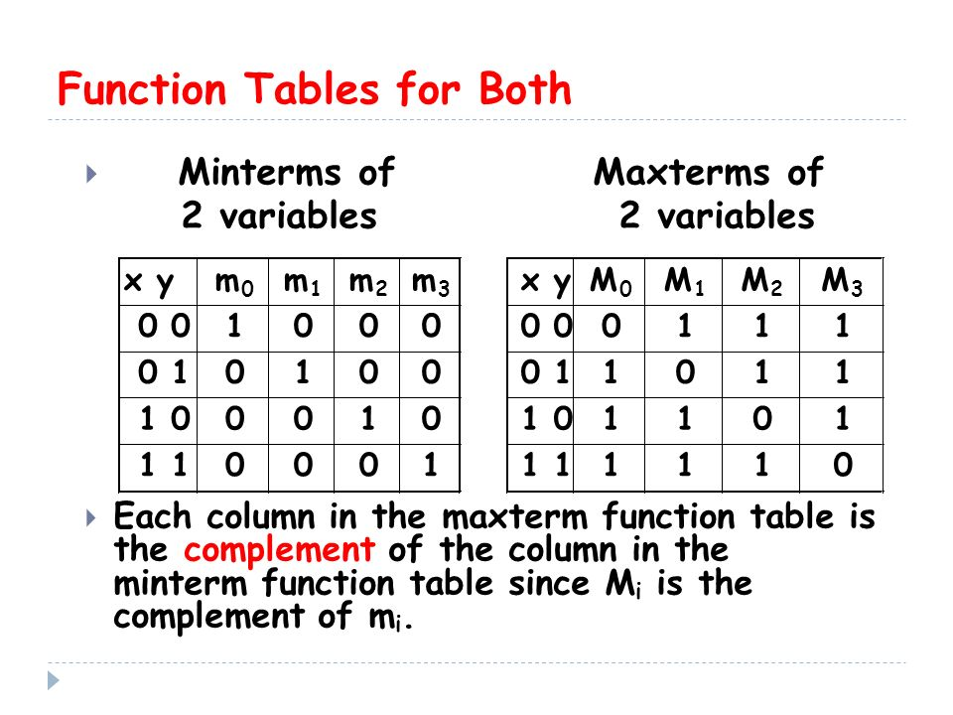
Minterms and Maxterms

Slide 49
Minterms and Maxterms

Slide 50
Canonical and standard forms
Logic function can be expressed in two forms
Sum of products (SOP)
Product of sums (POS)

Slide 51
Simplification of Boolean function using K map
A systematic method of simplification is the Karnaugh map ( ‘K map)
The map is a diagram consisting of squares
For n variables on a K map, 2^{n} numbers of squares
Each square or cell represents one of the minterms
Boolean function can be expressed as sum of minterms
Hence it is possible to recognize the Boolean function graphically in the map from the area enclosed by those squares whose minterms appear in the function

Slide 52
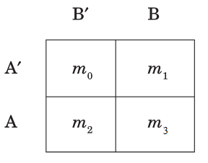
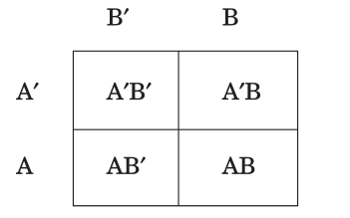
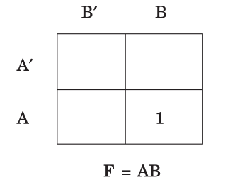
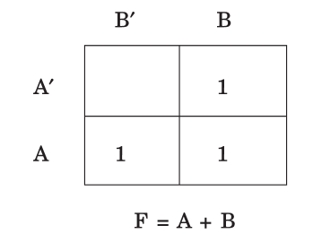
Two variable K map
Since two variable system can form four minterms, the map consists of four cells
(ie., one for each minterms)
K map for function
K map for function

Slide 53
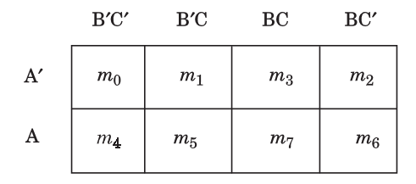
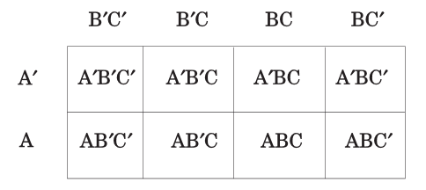
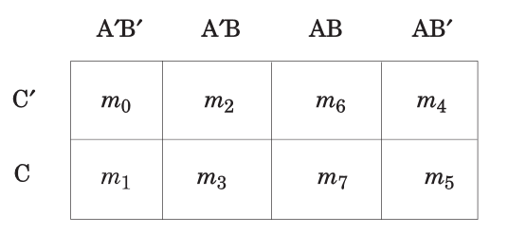
Three variable K map
Since eight minterms are there for three variables, the map consists of 8 cells or squares
Minterms are not arranged according to the binary sequence
Between two consecutive rows and columns only one single
Variable changes its logic from 1 to 0 or from 0 to 1

Slide 54
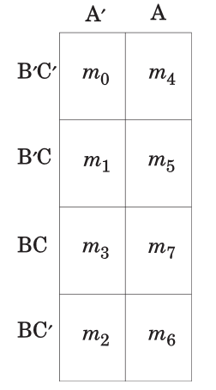
Three variable K map

Slide 55
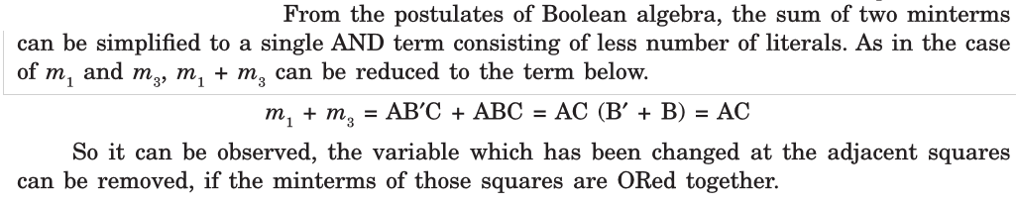
Three variable K map

Slide 56

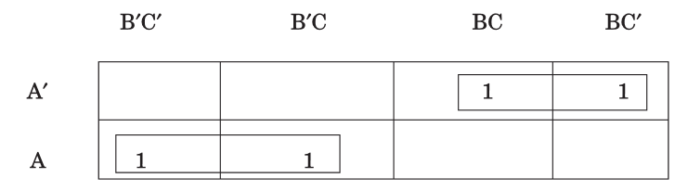
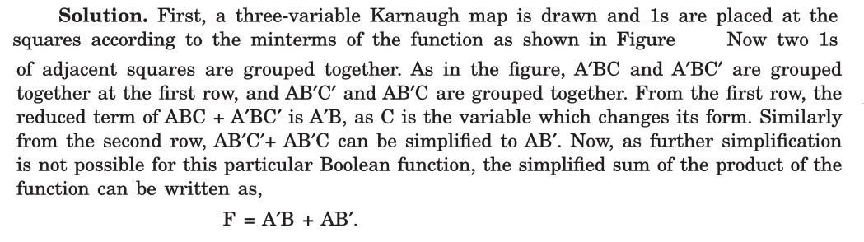
Three variable K map

Slide 57
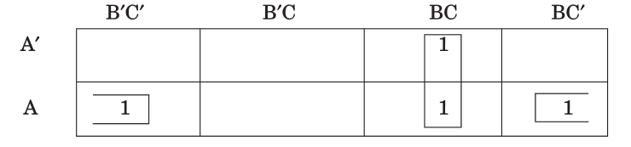


Three variable K map

Slide 58
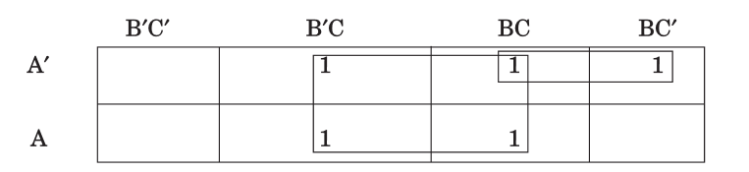

Three variable K map

Slide 59
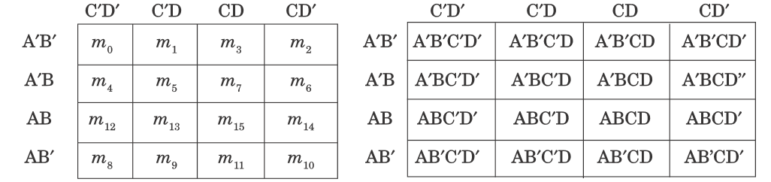
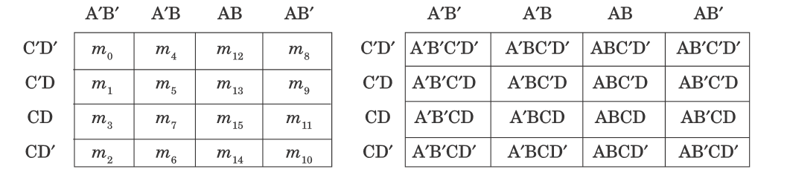
Four variable K map

Slide 60
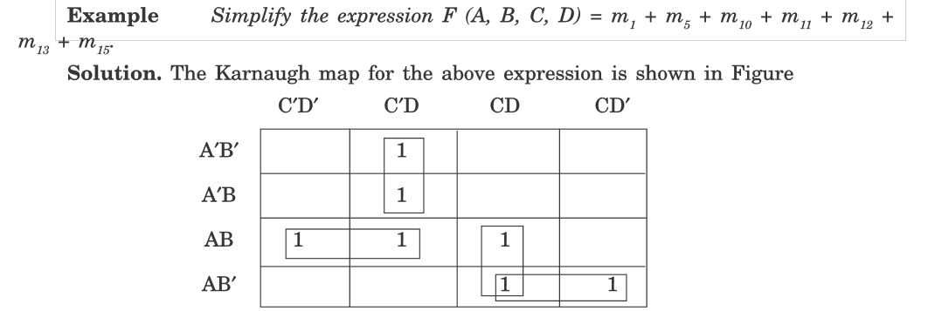
Four variable K map

Slide 61
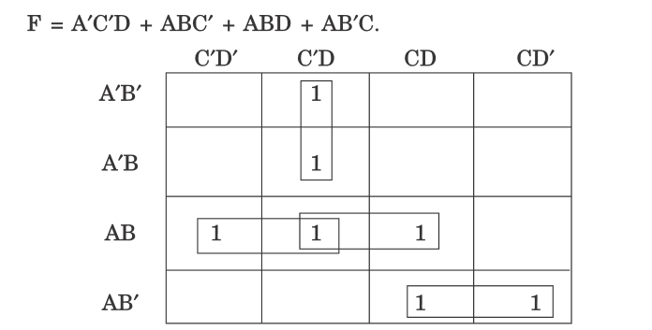
Four variable K map
(Another way of doing this)

Slide 62
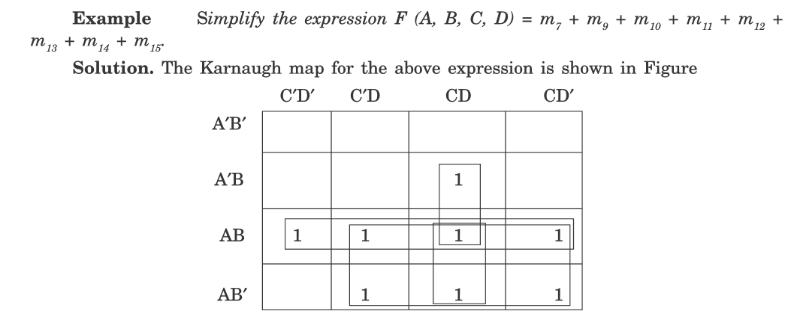

Four variable K map

Slide 63
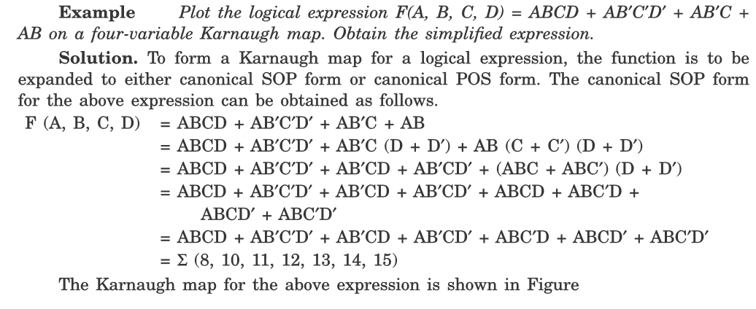
Four variable K map

Slide 64
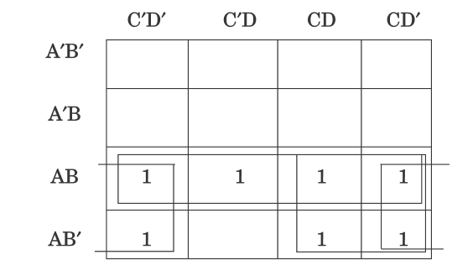
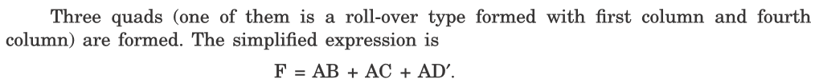
Four variable K map

Slide 65
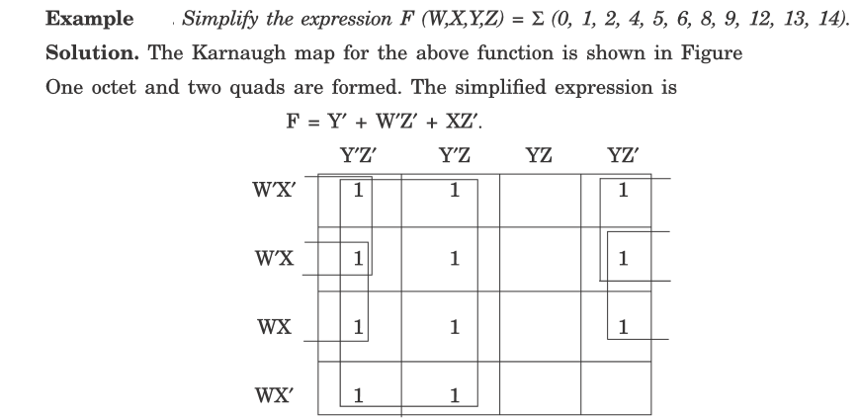
Four variable K map (Examples for your reference)

Slide 66
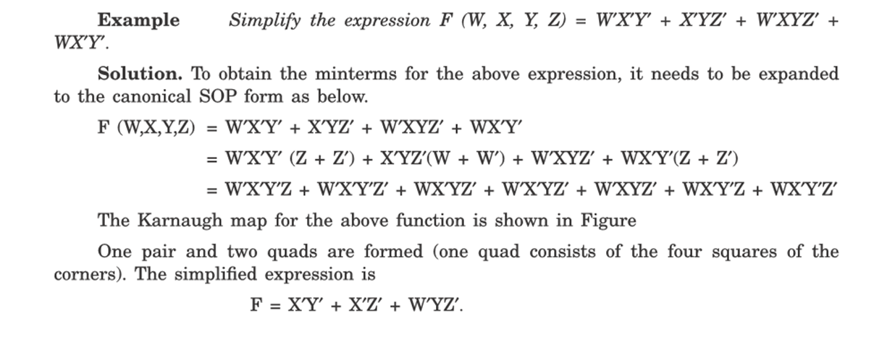

Four variable K map (Examples for your reference)

Slide 67

Four variable K map (Examples for your reference)

Slide 68

Practice Problems

Slide 69


Practice Problems

Slide 70



Practice Problems

Slide 71
Combinational and Sequential circuits
Examples of combinational circuits
are a half adder, full adder, magnitude comparator, multiplexer, demultiplexer, etc.
produce outputs immediately when their input changes.
Examples of sequential circuits
are flip-flop, register, counter, clocks, etc. ...

Slide 72
Combinational circuit
Adders
Half adder – Addition of two binary digits
Full adder – Addition of three binary digits
Subtractors
Half subtractor – Subtraction of two binary digits and produce the difference
Full subtractor - Subtraction of two binary digits taking a borrow

Slide 73
Half adder
S – LSB
C - MSB

Slide 74
Logic diagram of half adder
SOP

Slide 75
Logic diagram of half adder
POS

Slide 76
Logic diagram of half adder

Slide 77
Logic diagram of half adder

Slide 78
Logic diagram of half adder

Slide 79
Full adder circuit
Full adder is a combinational circuit that forms the arithmetic sum of three binary bits
It consists of three inputs (variables) and two outputs (Sum and carry)

Slide 80
Full adder circuit
The truth table for the full adder circuit

Slide 81
Full adder circuit
Implementation of full adder circuit

Slide 82





Full adder circuit
Implementation of full adder circuit with two half adders and OR gate

Slide 83
Subtractor – Half subtractor
Half subtractor is a combinational circuit, that subtract two bits and produces their difference
It performs x – y
If x >y……….
The result is ‘Difference bit’
If x<y……….
Then ‘1’ must be borrowed from the next higher stage ‘B’ is the borrowed quantity
The output B is 0 as long as x>=y

Slide 84
Half subtractor
The Boolean expressions for the outputs of
the half subtractor can be obtained as
follows

Slide 85
Full subtractor
x-y-z

Slide 86
Full subtractor
Drawing the K map for the function B and D gives

Slide 87
Multiplexer

Slide 88
Multiplexer
4 to 1 line multiplexer

Slide 89

Demultiplexer

Slide 90
Demultiplexer

Slide 91


Flipflops (Sequential logic circuit)-memory elements

Slide 92

RS flip or SR latch
Implementation using NOR gate

Slide 93
RS flip or SR latch
Implementation using NAND gate

